Slide 1
Team 3: Presents Team 5
Nils Forstall et al.
Notes:
Intro slide

Slide 2
Problem Domain
old problem domain
narrow to new problem domain

Slide 3
Roadmap
01
02
03
04
05
06
Additional Needfinding
POV Development
How Might We…
Brainstorm Solutions
Experience Prototypes
Next steps…

Slide 4
o1
Additional Needfinding results

Slide 5


Additional Needfinding Results
Mert
Jaston
A software engineer with a flexible, mostly empty schedule he fills with video games and “wasting time”
A Stanford student with a packed schedule and a strong aversion to large unplanned stretches of time

Slide 6
Takeaways from Mert

Slide 7
Takeaways from Jaston

Slide 8
02
POV Development

Slide 9
Initial POV(Erica)
We Met…
We were surprised to notice…
Erica, a Jehovah’s Witness Minister who is constantly checking her email for work related reasons.
That she knows she doesn’t receive any important communication after 5pm, but continues to check it frequently.
We wonder if this means…
It would be game changing to…
Checking her email is an ingrained habit, not a conscious choice
Help her stay consistently conscious of her communication habits

Slide 10
Revised POV #2: Mert
We Met…
We were surprised to notice…
Mert, a software engineer who works a hybrid schedule and comes to tressider on his out-of-office days.
He doesn't want to make his schedule more optimized for productivity, but he seemed embarrassed that it could be more productive.
We wonder if this means…
It would be game changing to…
He is unhappy with how he spends his time.
Help him feel content with the way he chooses to spend his time.

Slide 11
Revised POV #3: Jee
We Met…
We were surprised to notice…
Jee, a Korean family man who works 6-day weeks in pharma and wishes to get back into reading.
That he hopes that when his infant son grows up , that will free his schedule for reading but wasn't confident of that happening or the timeline.
We wonder if this means…
It would be game changing to…
That he copes with things he doesn't have time for by rationalizing that things will somehow change at unspecified points in the future.
Help him identify and re-integrate long-lost hobbies back into his schedule.

Slide 12
03
HMWs

Slide 13
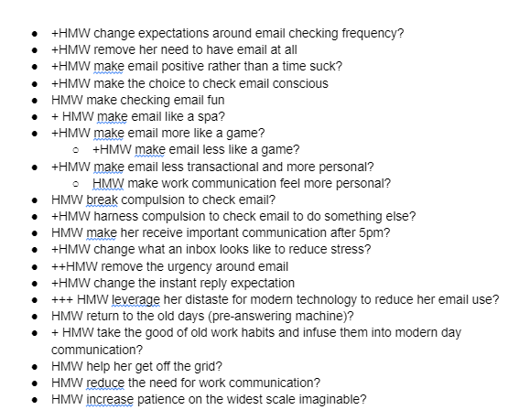
HMWs: Erica

Slide 14
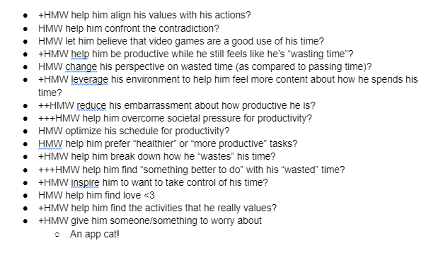
HMWs: Mert
Erica POV

Slide 15
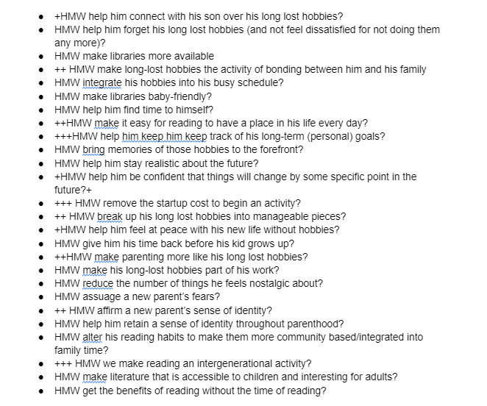
HMWs: Jee

Slide 16
04
Solutions

Slide 17
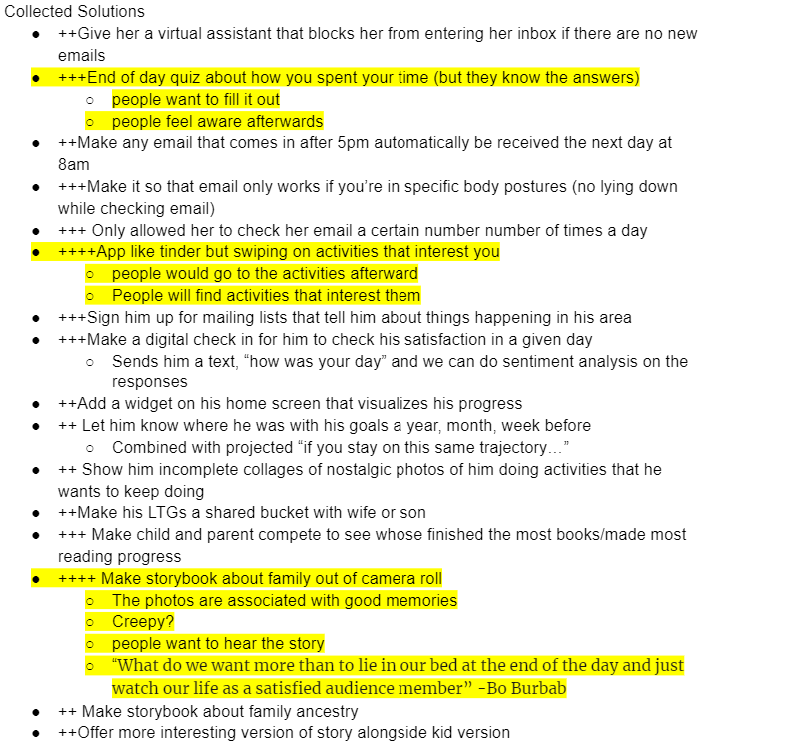
Solutions
3 best solutions
Brainstorms
End of Day Quiz
In slide notes, include screenshots of your brainstorms
Swipe on Activities that interest you
Storybook out of Camera Roll

Slide 18
05
Experience Prototypes

Slide 19
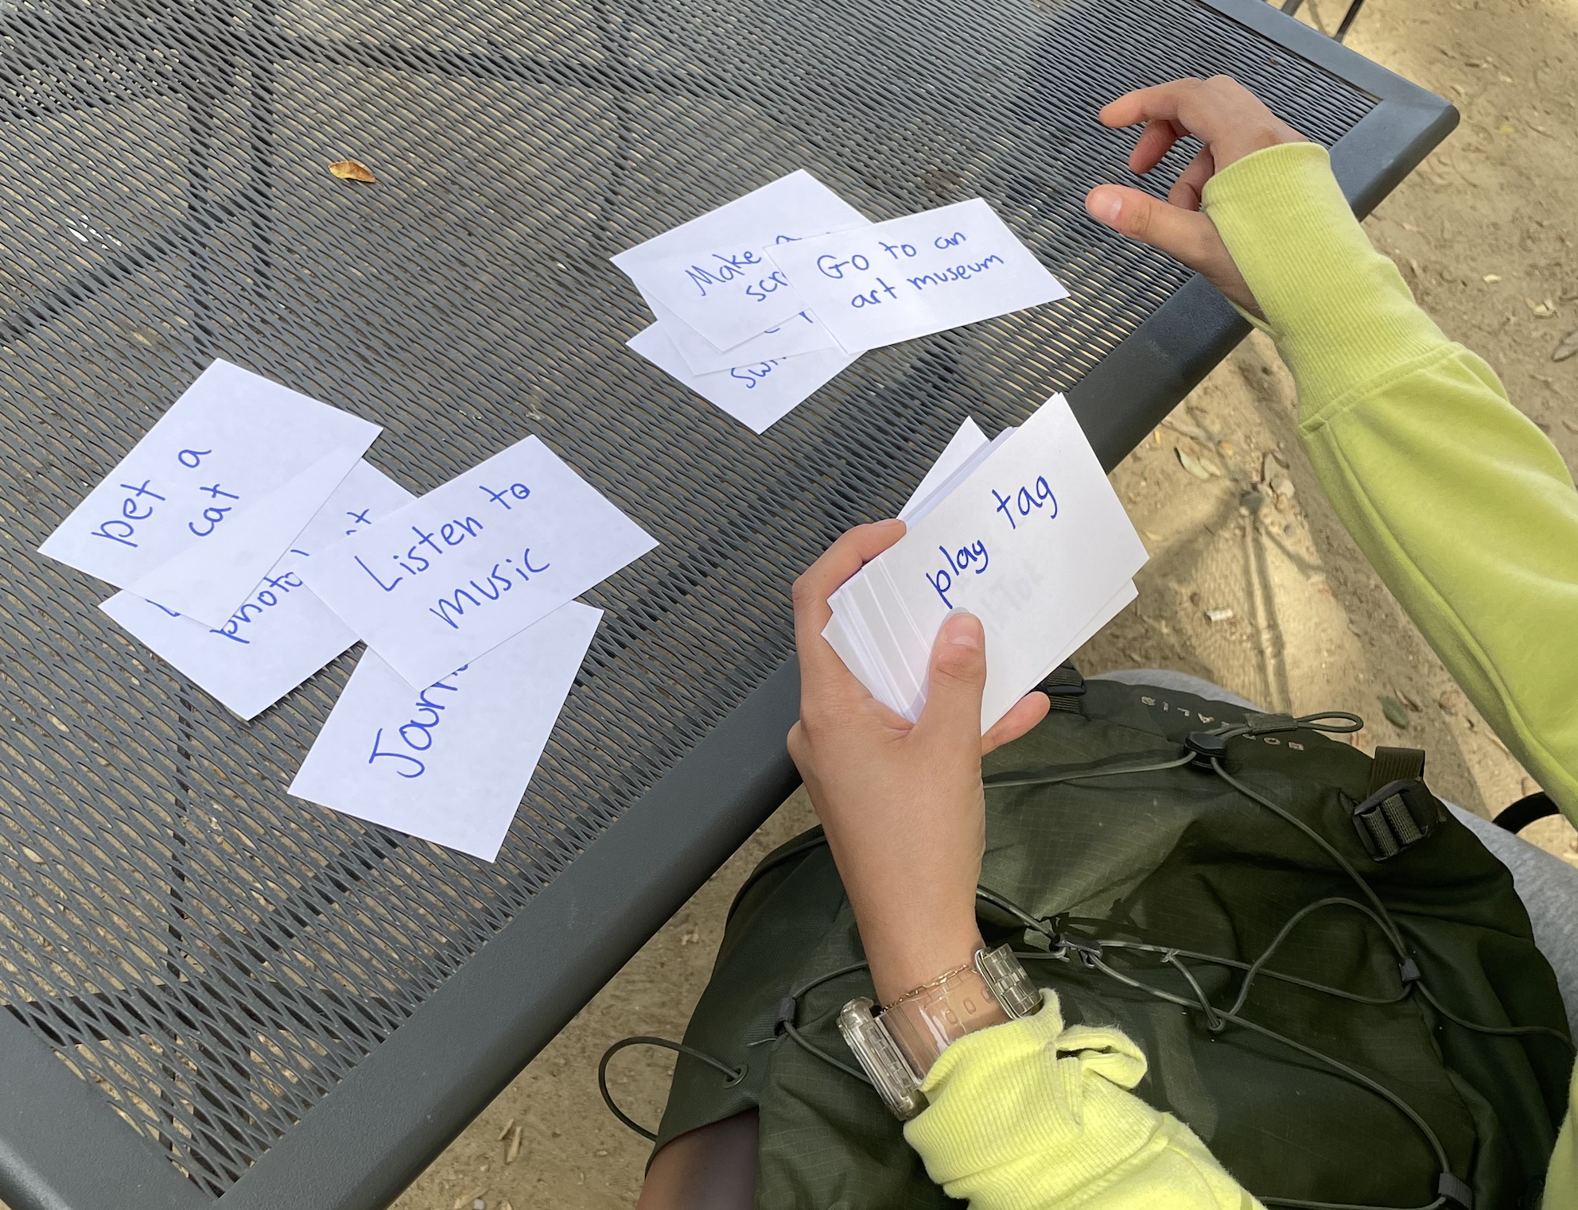
Experience Prototype: Tinder for Activities
Assumption
It’s easy and enjoyable to categorize activities as “interesting” or “not interesting”
Participants, Results

Slide 20
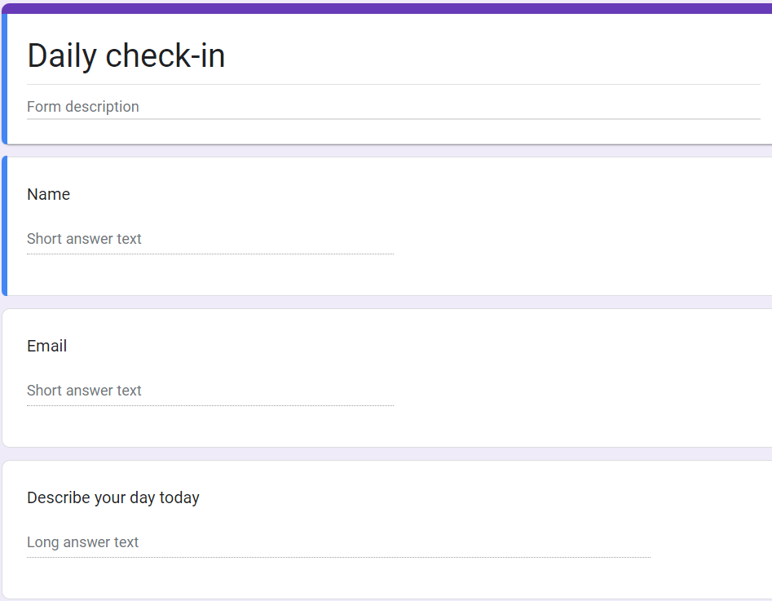
Experience Prototype 2- Daily Check in
Assumption
People want to fill out a form with their spare time
People will feel aware afterwards
Participants, Results

Slide 21
Experience Prototype 3
Assumption
Participants, Results
People will give us access to their camera roll.
Their camera roll has things they want to remember on it.

Slide 22
06
What's Next?

